Slide 1
MACHINE LEARNING BASIC REGRESSION
Achmad Rasis Mardhi
Teguh Prasetyo

Slide 2
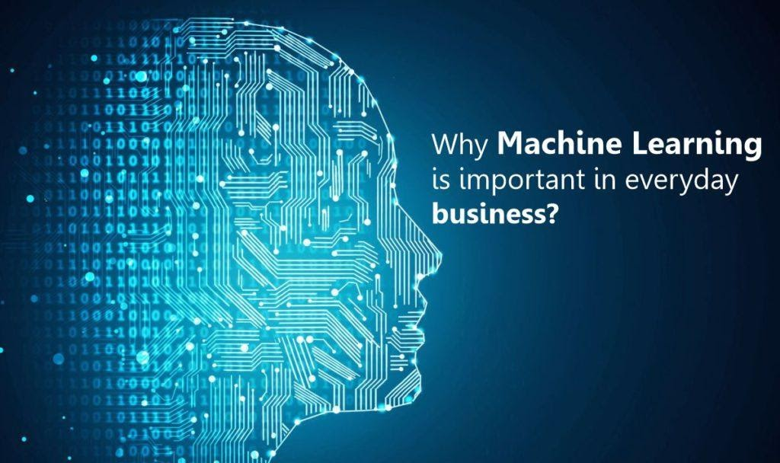
PENDAHULUAN: MENGAPA MACHINE LEARNING?
We are in the era of big data. The Internet and increasing presence of data capturing devices (such as mobile phones, cameras, sensors, card readers, etc.), combined with large reductions in the cost of storage, brought an unprecedented availability of data, and continued dramatic growth in the size of data sets.
Advances in computing power increase the scope for exploring complex patterns in data.

Slide 3
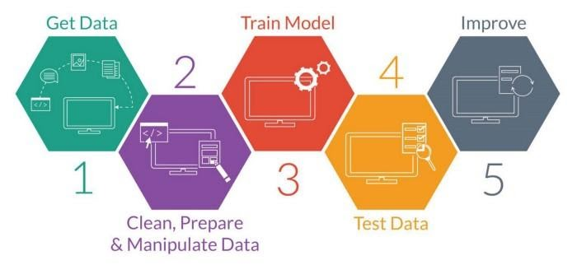
PENDAHULUAN: DEFINISI MACHINE LEARNING
Machine learning is a set of methods for automatically detecting patterns in data and using them for predicting future data and guiding decision making. In other words, learning from data.

Slide 4
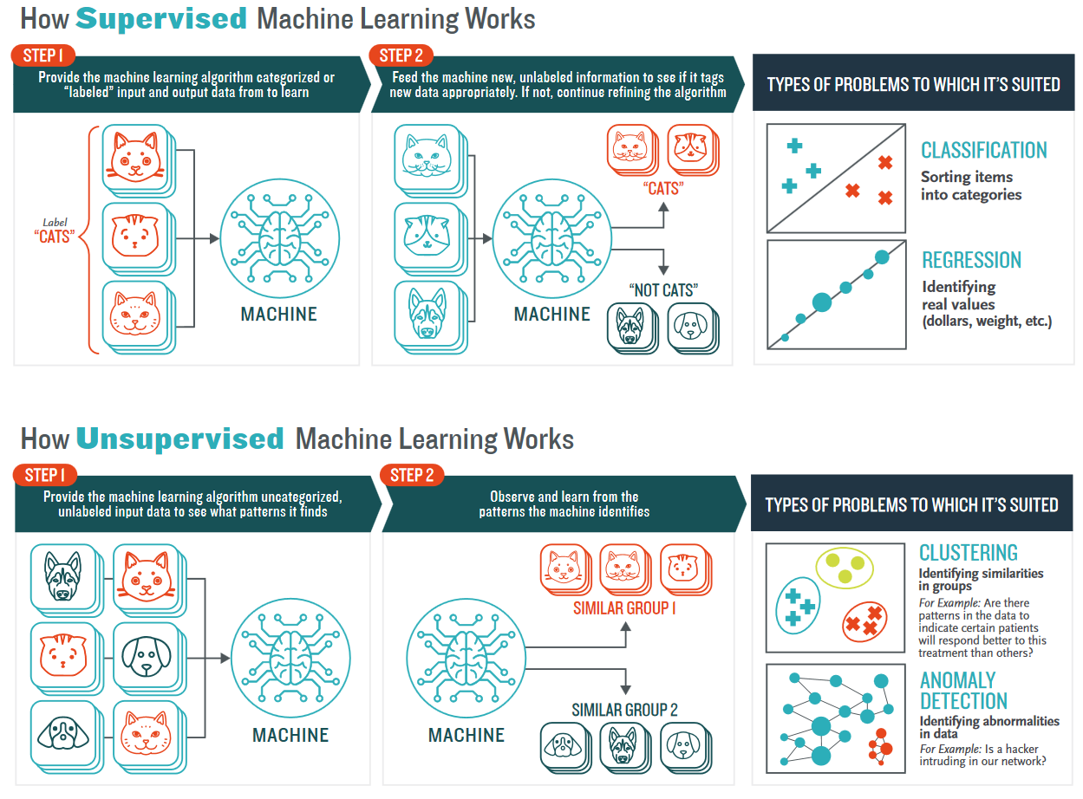
PENDAHULUAN: TYPES OF LEARNING
In predictive or supervised learning, the objective is to learn a function to predict an output variable Y based on observed input variables X1, . . . ,Xp.
In descriptive or unsupervised learning, we only have inputs, X1, . . . ,Xp, and the goal is to find “interesting” patterns in this data.

Slide 5
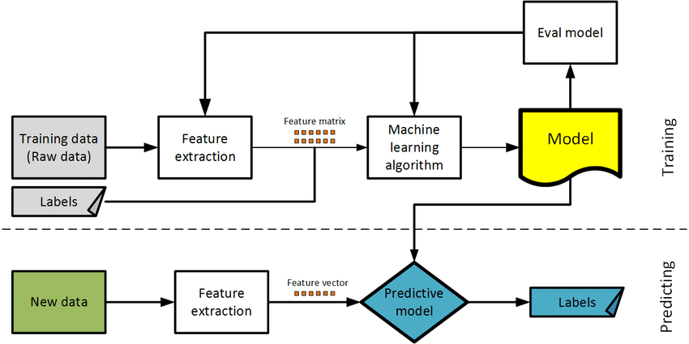
PENDAHULUAN: SUPERVISED LEARNING
In regression, the response is quantitative (such as a person’s credit card balance).
In classification, the response is a categorical variable. The case where the response takes only 2 different values corresponds to binary classification.

Slide 6
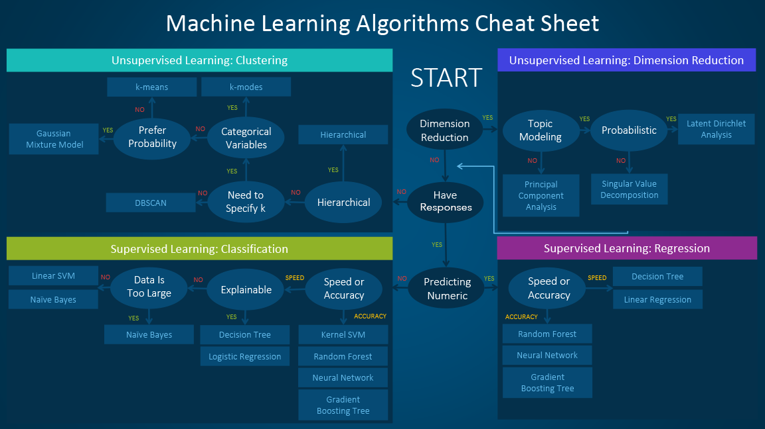
PEMILIHAN METODE MACHINE LEARNING
Tujuan analisis, tipe data yang dimiliki, serta karakteristik variabel mempengaruhi metode yang digunakan dalam Machine Learning

Slide 7
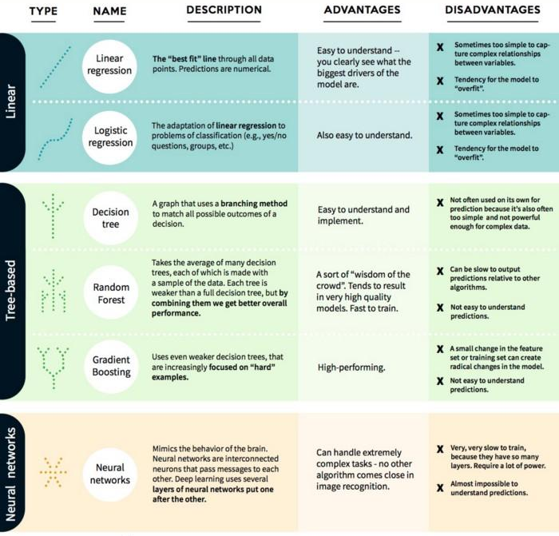
PERBANDINGAN ALGORITMA REGRESI
Algoritma Regresi sendiri memiliki banyak family, mulai dari Linear, Tree-Based, dan Neural Network yang masing-masing memiliki karakteristik serta keunggulan dan kelemahan berbeda-beda

Slide 8
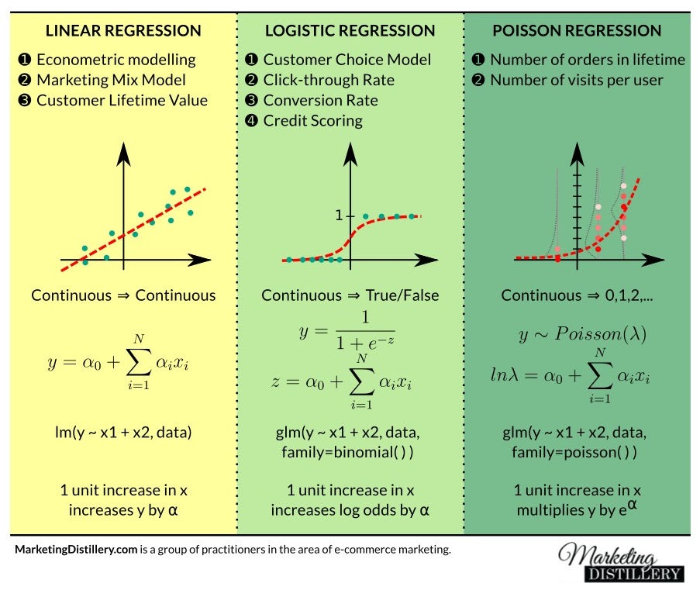
PERBANDINGAN ALGORITMA REGRESI
Algoritma regresi yang sering digunakan yakni Linear Regression, Logistic Regression, dan Poisson Regression dengan peruntukan masing-masing

Slide 9
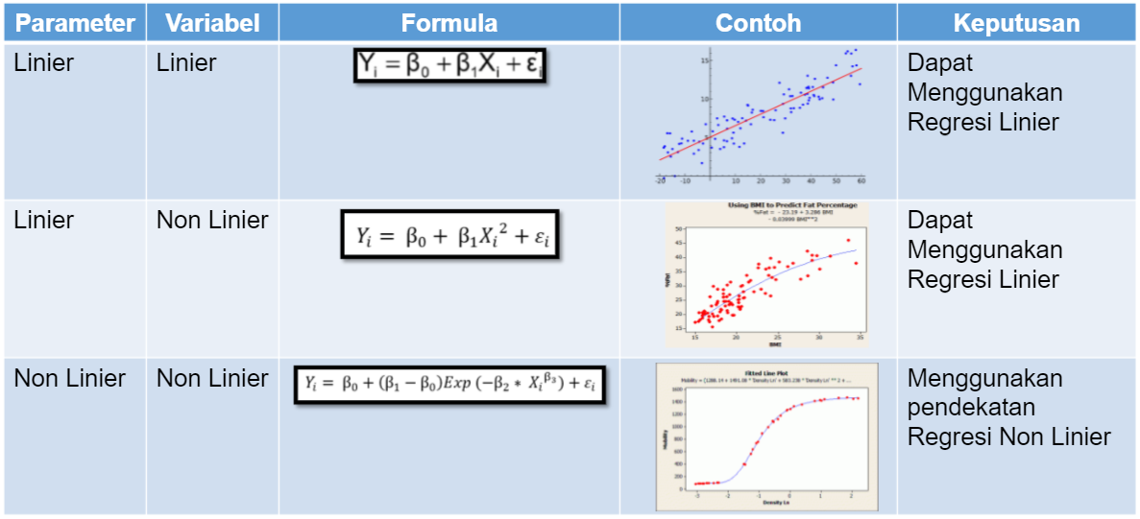
KAPAN MENGGUNAKAN REGRESI LINIER?

Slide 10
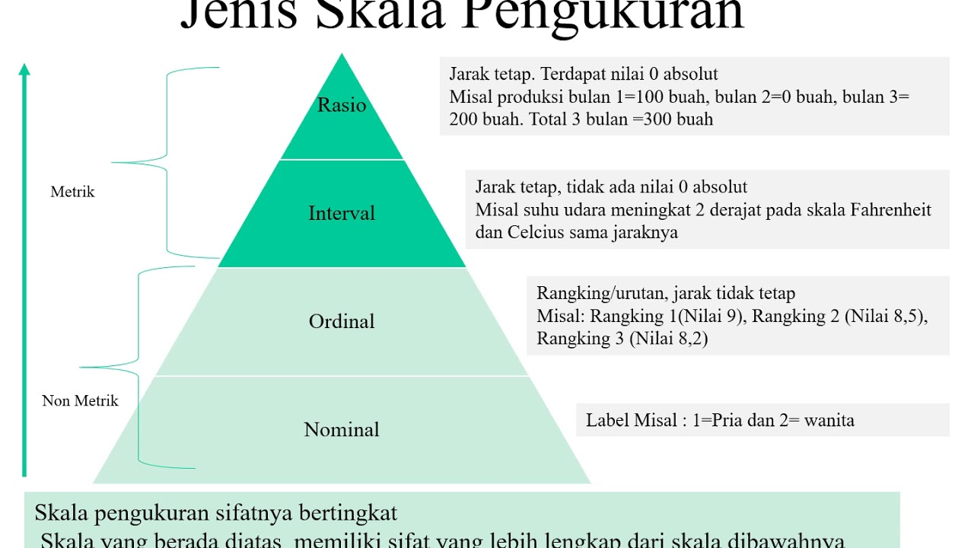
KAPAN MENGGUNAKAN REGRESI LINIER?
Regresi Linier dapat digunakan ketika variabel Y adalah data dengan skala metrik/kontinu (Interval atau Rasio), sedangkan variabel X bisa menggunakan tipe data apapun. Apabila variabel X bertipe data non metrik/kategori, dapat menggunakan Encoder terlebih dahulu

Slide 11
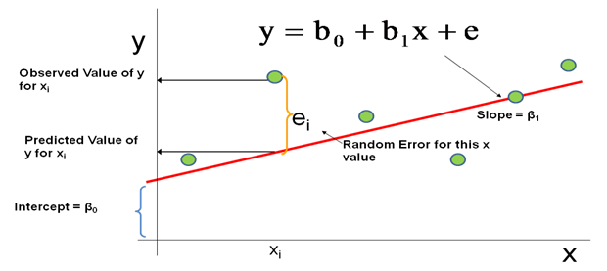
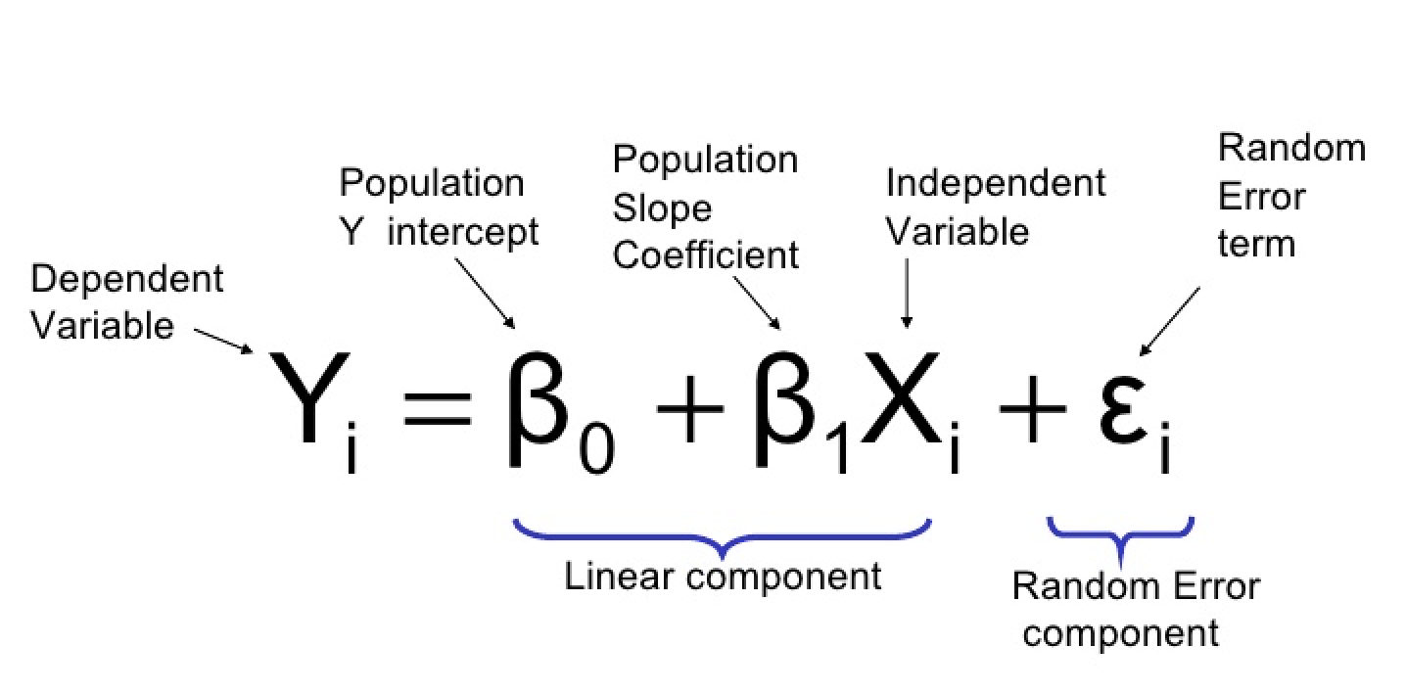

PENGANTAR ANALISIS REGRESI LINIER
Linear regression is a simple and widely used method for supervised learning. There are several important reasons for developing an in-depth understanding of this method.
It is extremely useful conceptually. Many advanced statistical learning methods can be understood as extensions and generalisations of linear regression.
Due to its simplicity, linear regression is often a good starting point for model building and analysis.
It works well for prediction in many settings.
It is easy to interpret.

Slide 12
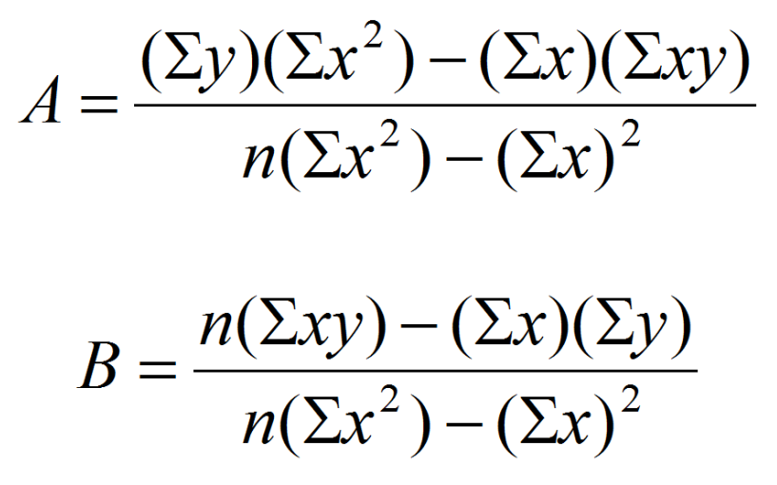

KOEFISIEN REGRESI LINIER (OLS)
Estimasi parameter pada regresi linier menggunakan prinsip model linier dengan metode Ordinary Least Square (OLS)

Slide 13
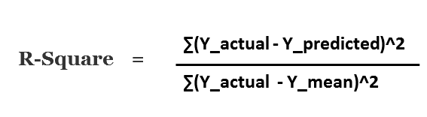
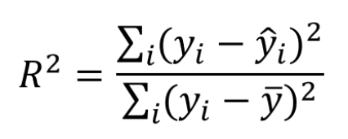
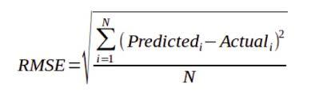
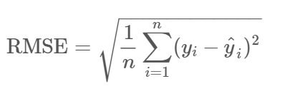
EVALUASI MODEL (AKURASI DAN EROR)
Akurasi maupun Error dapat digunakan sebagai acuan evaluasi model regresi yang terbentuk, di mana model yang baik memiliki akurasi tinggi dan error kecil

Slide 14
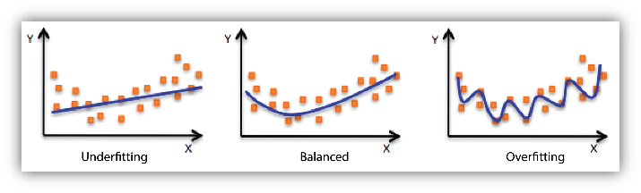
OVERFITTING VS UNDERFITTING
Model regresi yang baik adalah model yang tidak underfitting maupun overfitting.

Slide 15

CONTOH PENERAPAN PADA PYTHON

Slide 16

TERIMA KASIH

